Slide 1
OHM MEDICAL TRAINING
PARTNERED WITH JONES AND BARTLETT
PRESENTS
FIRST RESPONDER
POWERPOINT PRESENTATION
NOTE: These slides are to be used in conjunction with the OHM Medical First Responder Guide
JONES AND BARTLETT HAS PROVIDED PERMISSION TO OHM MEDICAL TRAINING TO USE THE J & B EMR POWERPOINT SLIDES
TO CREATE A PRESENTATION FOR OUR FIRST RESPONDER COURSE
Chapter 19:
Transport Operations

Slide 2
National EMS Education Standard Competencies (1 of 2)
EMS Operations
Knowledge of operational roles and responsibilities to ensure safe patient, public, and personnel safety.
Notes:
This presentation is intended to provide an overview for the First Responder on Transport Operations. The First Responder is not expected to transport but may assist in the operations at the scene. It will be good to familiarize the First Responder to the process.

Slide 3
National EMS Education Standard Competencies (2 of 2)
Principles of Safely Operating a Ground Ambulance
Risk and responsibilities of emergency response
Air Medical
Safe air medical operations
Criteria for utilizing air medical response

Slide 4
Introduction
To be an effective first responder (FR), you need to
Prepare for the call.
Review dispatch information.
Respond safely to the scene.
Perform a scene size-up.
Perform initial patient assessment and assist with emergency care.
Update other responding units and transfer care to other emergency medical services (EMS) personnel.
Complete postrun activities.

Slide 5
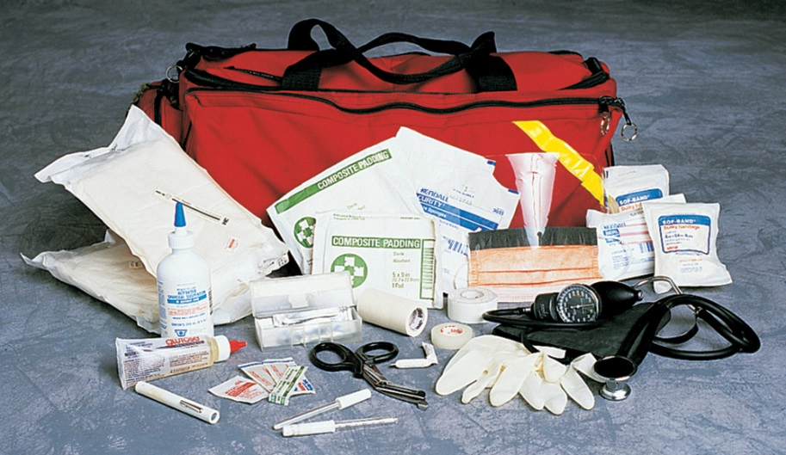
Preparing for a Call (1 of 2)
Preparing for a call
Ensure that your vehicle is ready to respond at all times.
Be prepared to respond promptly using the most direct route available.
Make sure you have the proper equipment.
© Jones & Bartlett Learning. Courtesy of MIEMSS.

Slide 6
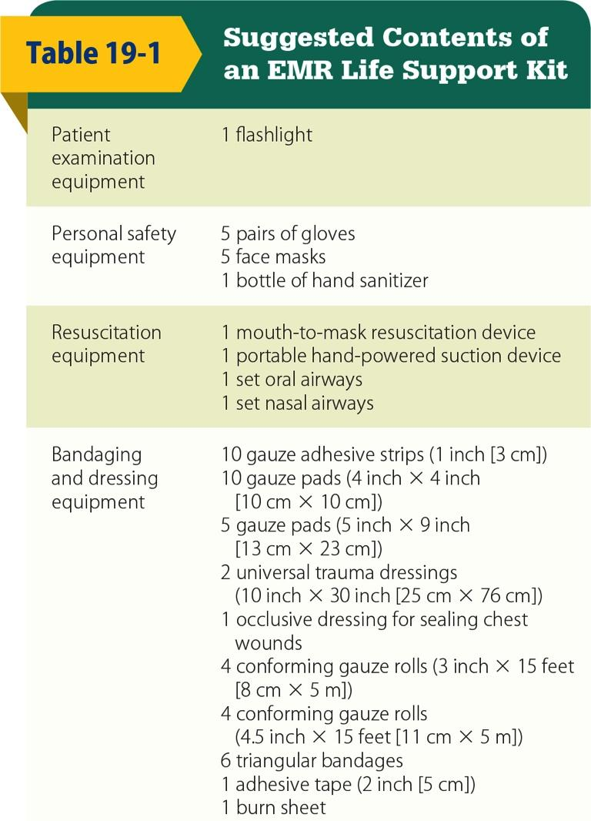
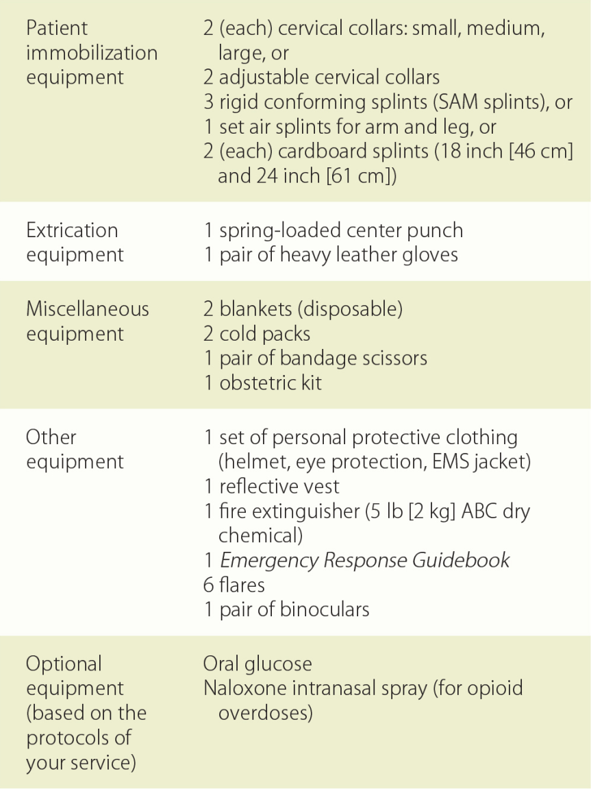
Preparing for a Call (2 of 2)
© Jones & Bartlett Learning.

Slide 7
Phases of a First Responder Call (1 of 6)
Dispatch
The dispatch facility is a center that citizens can call to request emergency medical care.
Most centers are part of a 9-1-1 system.
Dispatchers should obtain proper information from the caller and instruct callers on how to perform life-saving techniques until you arrive.

Slide 8
Phases of a First Responder Call (2 of 6)
Information from dispatch should include
Nature of the call
Name and location of the patient
Number of patients
Any special problems
Call-back number from the caller

Slide 9
Phases of a First Responder Call (3 of 6)
Response to the scene
Get to the scene quickly and safely.
Consider traffic patterns and the time of day.
Use seatbelts.
Keep all equipment secured.
Use warning devices according to state laws.
Do not exceed a safe speed.
Drive defensively.

Slide 10
Phases of a First Responder Call (4 of 6)
Arrival at the scene
Place your vehicle in a safe location.
Perform a scene size-up.
Look for hazards.
Control the flow of traffic.
Determine the number of patients and the need for additional resources.
Provide patient care.

Slide 11
Phases of a First Responder Call (5 of 6)
Transferring the care of the patient to other EMS personnel
Give them a brief report of the situation and tell them what care you have provided.
Ask them if they have any questions for you.
Offer to assist them in caring for the patient.

Slide 12
Phases of a First Responder Call (6 of 6)
Post run activities
Complete the paperwork.
Clean your equipment and replace needed supplies.
Only after you have completed these activities should you resume regular duties or notify your dispatcher that you are ready for another call.

Slide 13
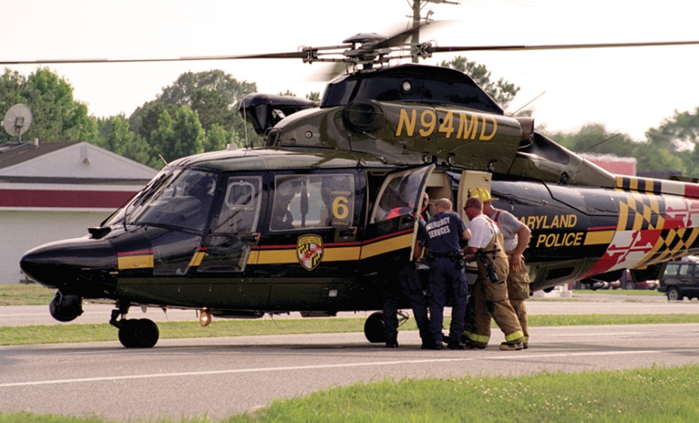
Helicopter Operations (1 of 3)
Helicopters are used by EMS systems to
Reach patients
Transport patients to medical facilities
Remove patients from inaccessible areas
© Mark C. Ide.

Slide 14
Helicopter Operations (2 of 3)
Helicopters have several advantages.
They can respond quickly above traffic congestion and wilderness areas.
They usually carry specialized equipment.
Their personnel may be able to perform some advanced skills not available from personnel staffing ground ambulances.
Helicopters are limited by bad weather.

Slide 15
Helicopter Operations (3 of 3)
If your EMS system uses a helicopter
Obtain a copy of the ground operations procedures.
Schedule an orientation session with helicopter personnel.
Know how to request a helicopter response as well as what the criteria for calling a helicopter for trauma patients, medical patients, and wilderness response are.

Slide 16
Helicopter Safety Guidelines (1 of 5)
Helicopters can be dangerous to untrained personnel.
The main rotors spin at 300 rpm and may be just 4′ above the ground.
The tail rotor spins at more than 3,000 rpm, and may be invisible to an unwary person.
The rotors can generate winds of 60 to 80 mph.

Slide 17
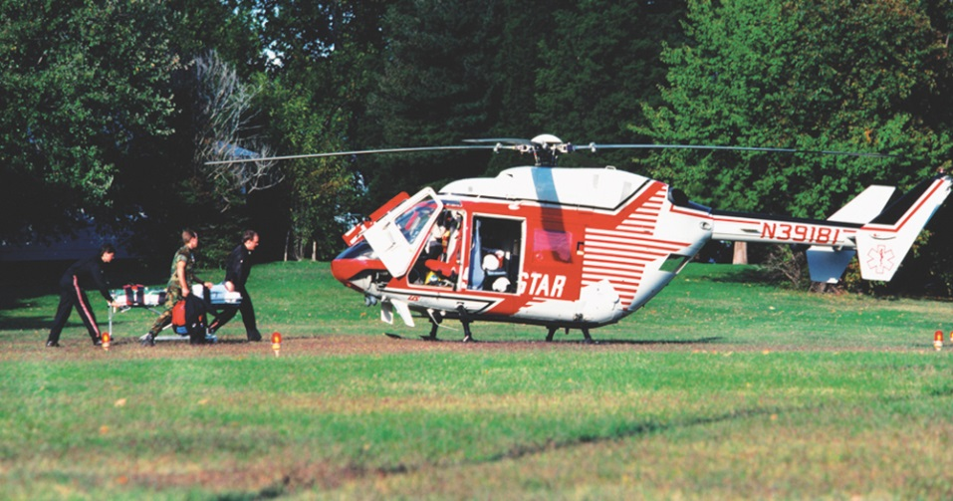
Helicopter Safety Guidelines (2 of 5)
Setting up landing zones
Pilots usually land and take off into the wind.
Most civilian helicopters need a landing zone of 100’ × 100’.
The landing zone should be as flat as possible and free of debris.
© Thomas R. Fletcher/Alamy.

Slide 18
Helicopter Safety Guidelines (3 of 5)
Setting up landing zones (cont’d)
Check for any nearby wires.
If the site slopes or has any obstacles, notify the pilot.
When marking the area, avoid using flags, fusees, or flashing emergency lights.
Keep vehicles clear of the landing zone.

Slide 19
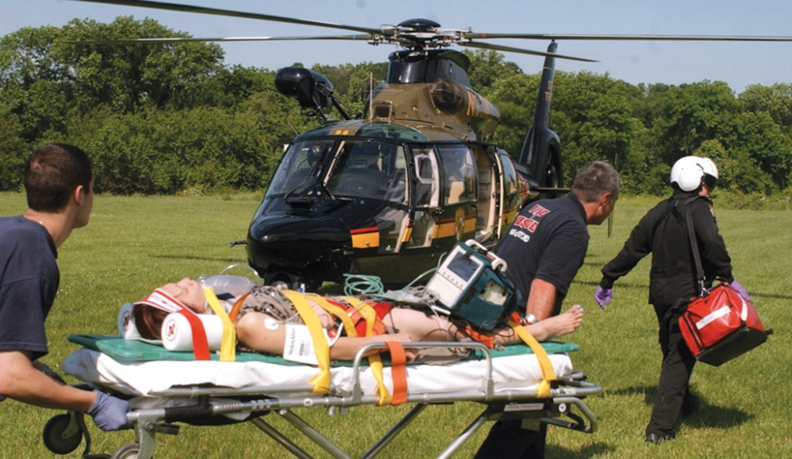
Helicopter Safety Guidelines (4 of 5)
Loading patients into helicopters
Secure all loose clothing, sheets, and instruments.
Use eye protection.
Approach a helicopter from the front and only after the pilot signals that it is safe.
© Mark C. Ide.

Slide 20
Helicopter Safety Guidelines (5 of 5)
Loading patients into helicopters (cont’d)
Follow the helicopter crew’s instructions.
Give the patient report to the crew, away from the noise, and offer your assistance.
Patients need to be packaged properly and securely.

Slide 21
Summary (1 of 2)
As a First Responder, you need the proper equipment on an emergency call, including the medical equipment in your life support kit, your personal safety equipment, and equipment to safeguard the accident scene.

Slide 22
Summary (2 of 2)
The six phases of an emergency call are preparation, dispatch, response to the scene, arrival at the scene, transferring care of the patient to other EMS personnel, and postrun activities.

Slide 23
Review
Which of the following is NOT one of the phases of an FR call?
Arrival at the scene
Post run activities
Scheduling for upcoming shifts
Preparation

Slide 24
Review
Answer:
C. Scheduling for upcoming shifts

Slide 25
Review
Information from dispatch should include all of the following EXCEPT the
number of patients.
nature of the call.
nearest hospital.
call-back number.

Slide 26
Review
Answer:
C. nearest hospital.

Slide 27
Review
When approaching a helicopter, you should
always approach from the rear.
always approach from the front.
attempt to move the patient to the aircraft as soon as it lands.
not need eye protection.

Slide 28
Review
Answer:
B. always approach from the front.

